Slide 1
Projet Kubernetes
Présentation

Slide 2
Sommaires
01
02
03
Introduction
Controller Ingress
Micro-service
04
05
Prometheus
Elastic/Kibana

Slide 3





Introduction
Application
Leo.B & Kylian.B & Paco.H

Slide 4
Kubernetes
Controller-ingress
Micro-service Helm
Monitoring

Slide 5
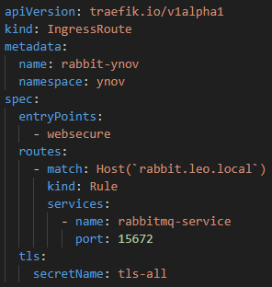
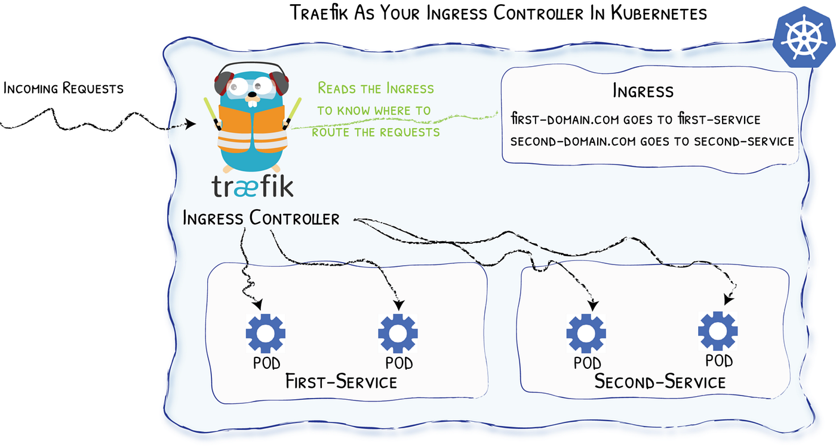
Controller-ingress

Slide 6
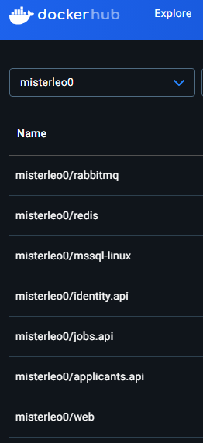
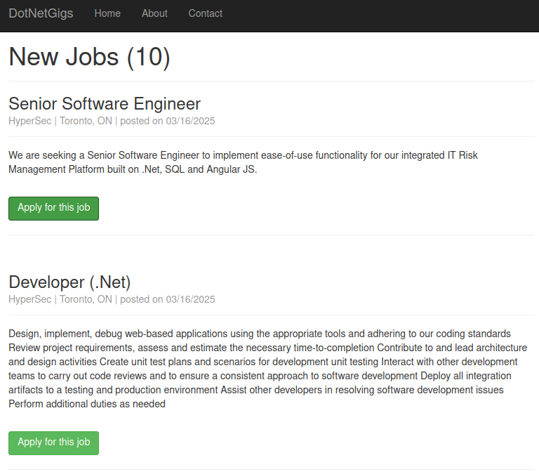
Micro-service Helm

Slide 7
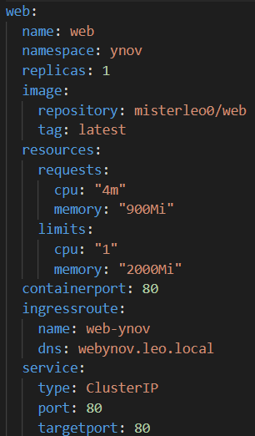
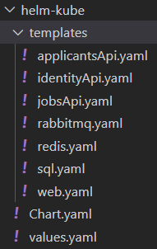
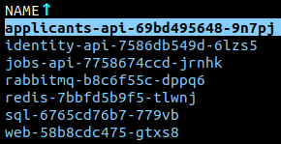
Micro-service Helm
Chart Helm

Slide 8
Monitoring / Logs
Prometheus
ElasticSearch / Kibana / FileBeat

Slide 9
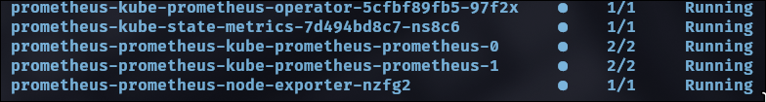
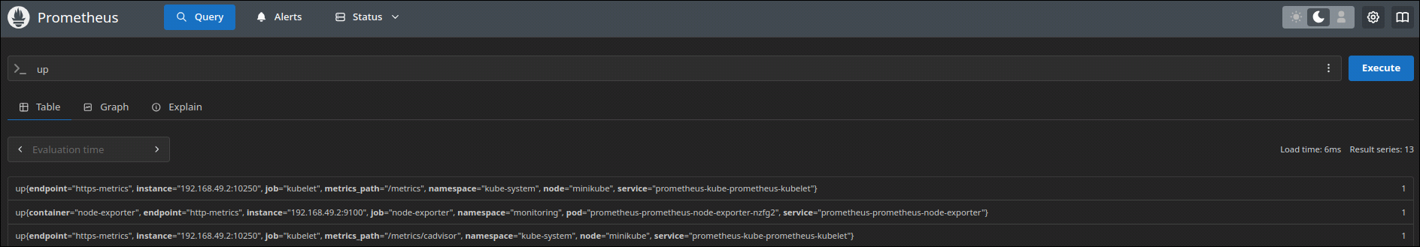
Prometheus
Pods is running
Interface

Slide 10
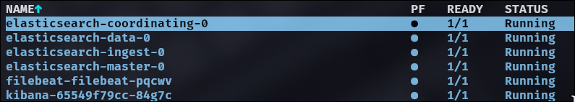
ElasticSearch / Kibana / FileBeat
Pods
(Les logs)
FileBeat
(Le mangeur)
ElasticSearch
(Le Cerveau)
Kibana
(Le Beau gosse)

Slide 11
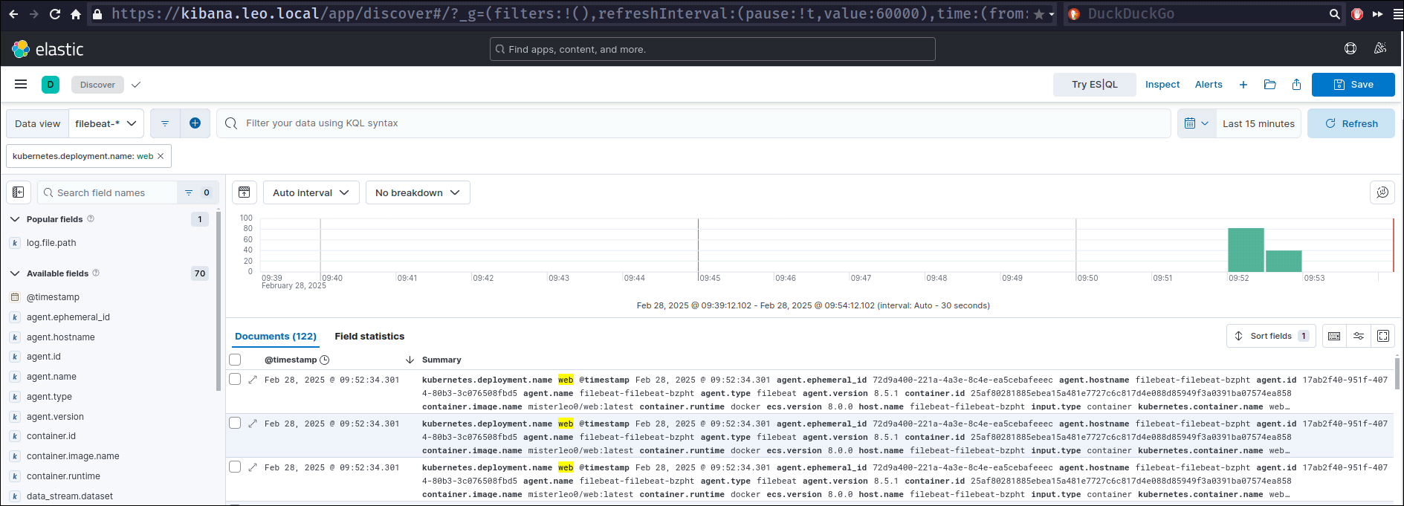
ElasticSearch / Kibana / FileBeat

Slide 12
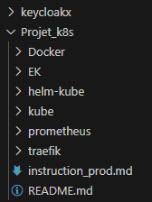
DEMO
Ingress-Controller:
Traefik
Helm + MicroService:
Chart-Helm
Resources
Bilan de Santé:
Prometheus
Logs:
Kibana
ElasticSearch
FileBeat

Slide 13

Des questions ?

